Slide 1
Facilitating Transfer and Delivery of Technologies:
Experiences from AATF
By
Dr Francis Nang’ayo
Head of Policy and Regulatory Affairs
African Agricultural Technology Foundation (AATF)
5th ANNUAL BIOSAFETY FORUM,
Kampala, Rwanda

Slide 2
Outline
Introducing AATF
Case Studies
  Development and delivery of PBR Cowpea in Africa
  WEMA-TELA Maize Project
  Other projects on GM crops
Concluding Remarks

Slide 3
AATF’s vision, mission and objectives
AATF is about empowering smallholder farmers across sub-Saharan Africa with agricultural innovations that can generate wealth and health for their families including women and youth, communities and countries
AATF Strategic Objectives 2018 -2022
VISION:
MISSION:
To transform livelihoods
through innovative agricultural technologies to improve incomes and improve Food and Nutrition Security
A prosperous
and food secure Africa
1
Diversify agricultural technologies accessed for use in SSA
2
Accelerate commercialisation of agricultural technologies for improved farmers livelihoods
Build Robust Public Private Partnerships
VALUES:
Integrity
3
Create an enabling environment for increased uptake and use of agricultural technologies in SSA
Define the principles that shape what AATF is and what it champions.
Dedication
Accessibility
Increased adoption of commercialized agricultural technologies by farmers in Sub-Saharan Africa

Slide 4
Access & Delivery of Technologies: AATF Approach
Scouting & licensing
Advanced prod. development
Marketing
Sales
Agricultural Innovation Platform
Early prod. development
Deployment
Notes:
The Seed System or SEED VALUE CHAIN refers to a set of activities carried out during research, development, screening, registration, certification, production and delivery of seed to end users (farmers).
Typically this encompasses upstream R&D activities that if successful results in candidate germplasm for variety screening, followed by seed production through marketing and sales
For this to happen and happen efficiently, it has to be supported by enabling environment comprising of ……..
In practice Seed Systems in Africa have malfunctioned for reasons that are many and well known to most of us. Many studies conducted reported a plethora of challenges hampering functioning of seed systems in Africa – ranging from ???????????
The work of AATF and TASAI focuses on the Enabling Environment, and for us AATF the area of policy implementation.
As this is an area we have been working in for some years, and now constitutes one of STRATEGIC AREAS OF FOCUS
FOR INSTACNCE

Slide 5


STI at a Glance
…modern world is unimaginable without ST&I…

Slide 6
Case studies from AATF collaborations

Slide 7
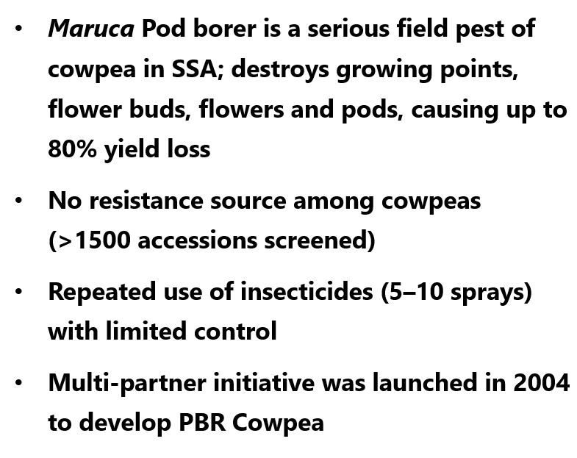
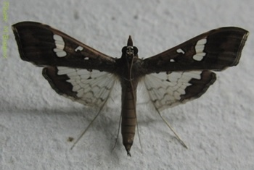
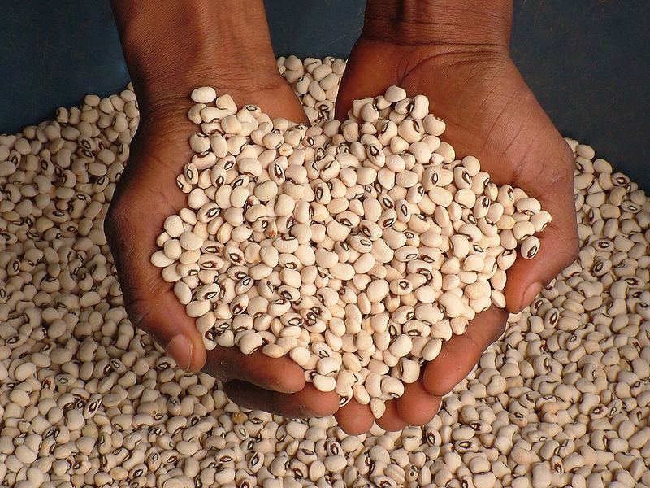
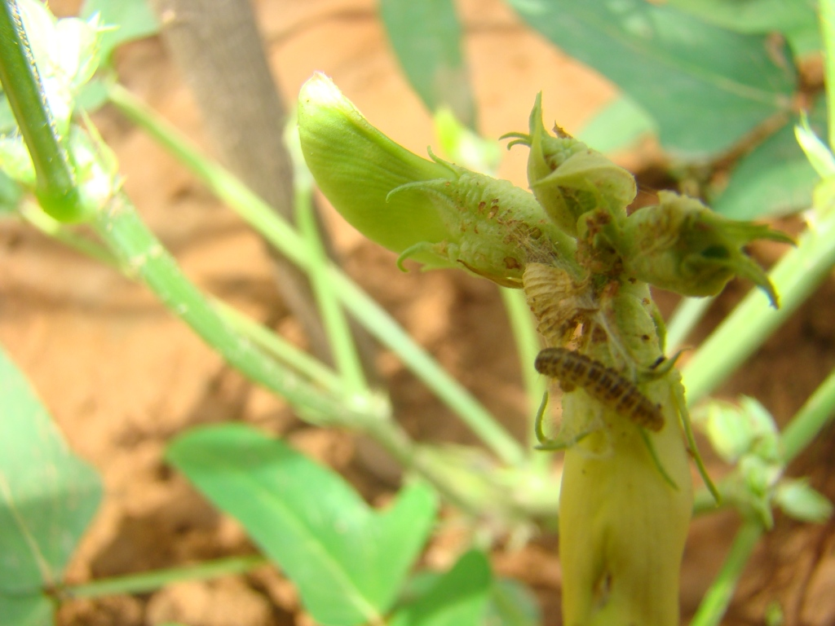
1. Development & Delivery of PBR Cowpea
Partners: AATF, USAID, Bayer, CSIRO, NARS*, NGiCA and SeedCos

Slide 8

Winding Road from Concept to Product!
2021
Compilation of safety and efficacy data; Submission of Dossier; Review and Approval in Nigeria ….Variety testing, LAUNCH!
2013 -17
Agronomic Trials, Compositional analysis; Food/feed assessment, Environmental studies, introgression etc (3 countries)
2009 - 12
1st Wave of field trials in Nigeria; B. Faso
2008 - 09
2004/05
Preliminary Field Trials (Puerto Rico)
2007/08
Negotiations for royalty free access to Bt technology
Gene constructs; Cowpea Transformation; Screening; Event Characterization etc

Slide 9
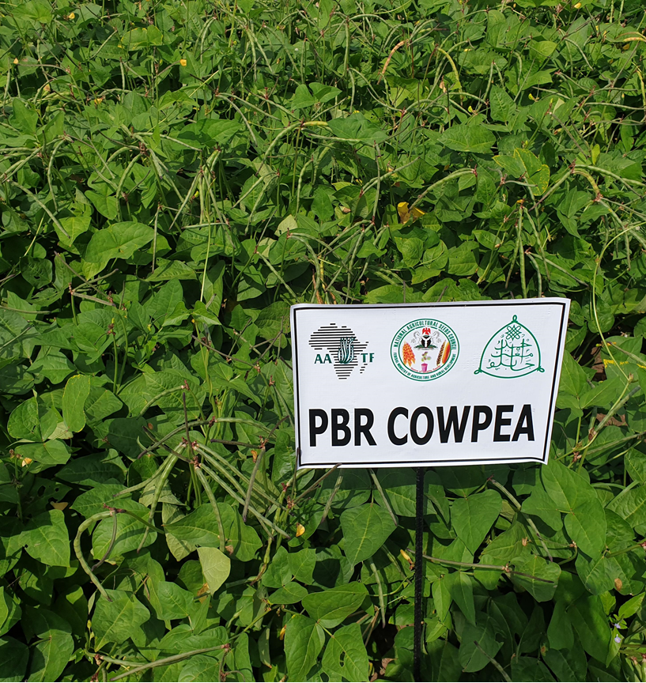
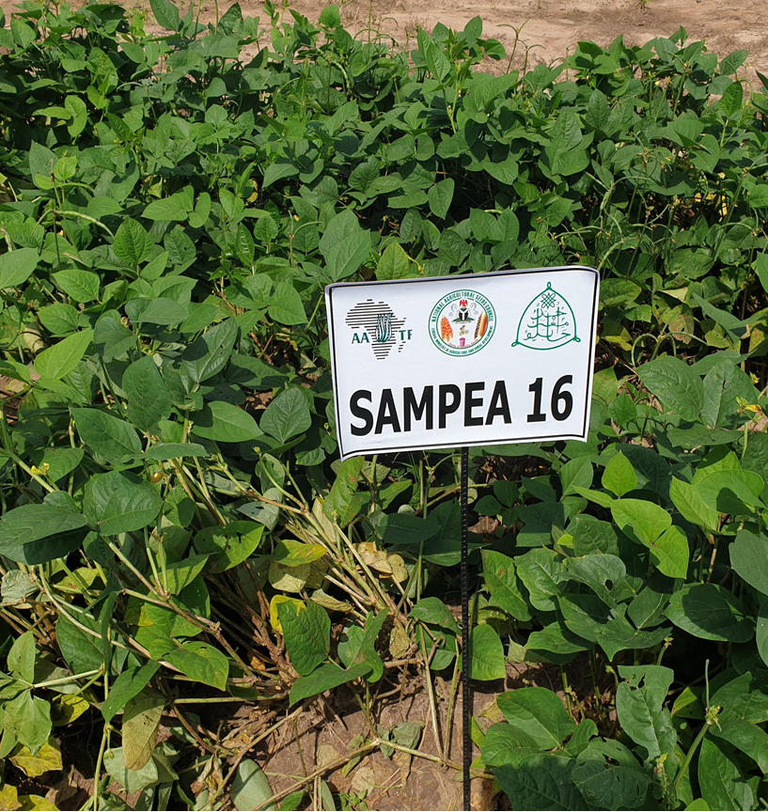
Agronomic Performance of PBR Cowpea On-Farm
PBR Cowpea (SAMPEA 20-T ) Approved for Commercialization in 2019*; launched in 2021

Slide 10
Re-cap: PBR Cowpea
PBR Cowpea project represents over 15 years of investment in PPP to develop and deliver an innovation for insect protection for farmers in Africa
Approval and launch of PBR cowpea in Nigeria is a historic milestone – a first of its kind in Africa!
Similar progress is expected in Ghana and Burkina Faso
Progress in Malawi is rather slow and uncertain

Slide 11
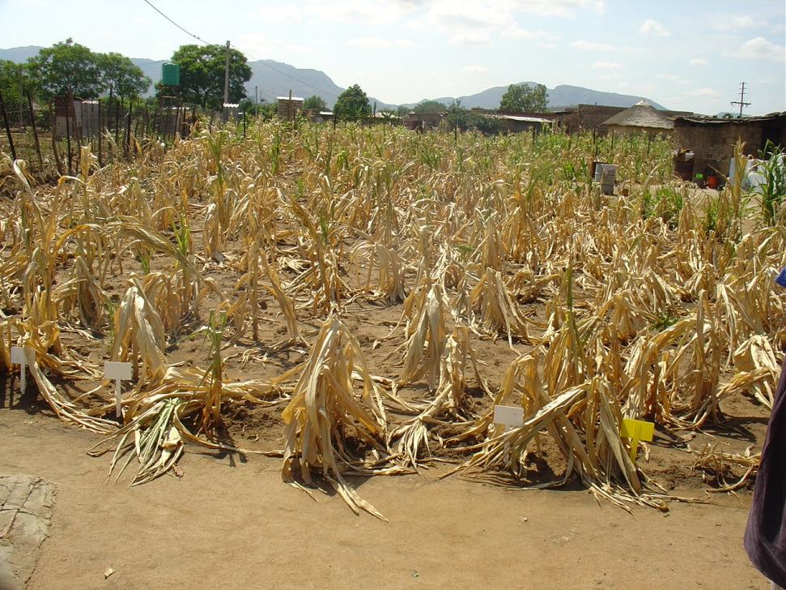
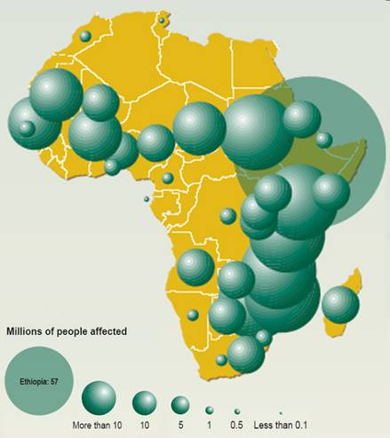
2. WEMA – TELA Maize Project: Delivery of climate-smart, Insect Resistant Maize Varieties
Recorded droughts between 1971 and 2000,
On-farm maize, Mokopane, RSA
Over 300 Million people depend on maize in Africa
High maize consumption in Africa; highest in Southern Africa (Lesotho:120 kg/yr/p)
Frequent droughts lead to reduced production, loss of investments; and food insecurity
Notes:
More than a third of African population depend on maize as major food source
Consumption is highest in Southern Africa e.g. Lesotho with 120kg/yr/person

Slide 12
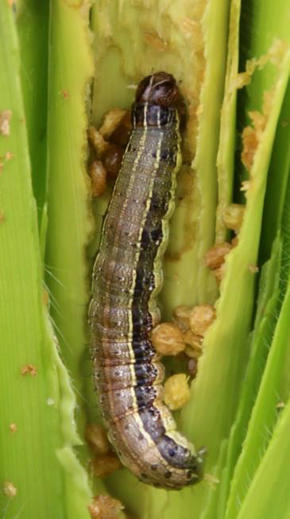
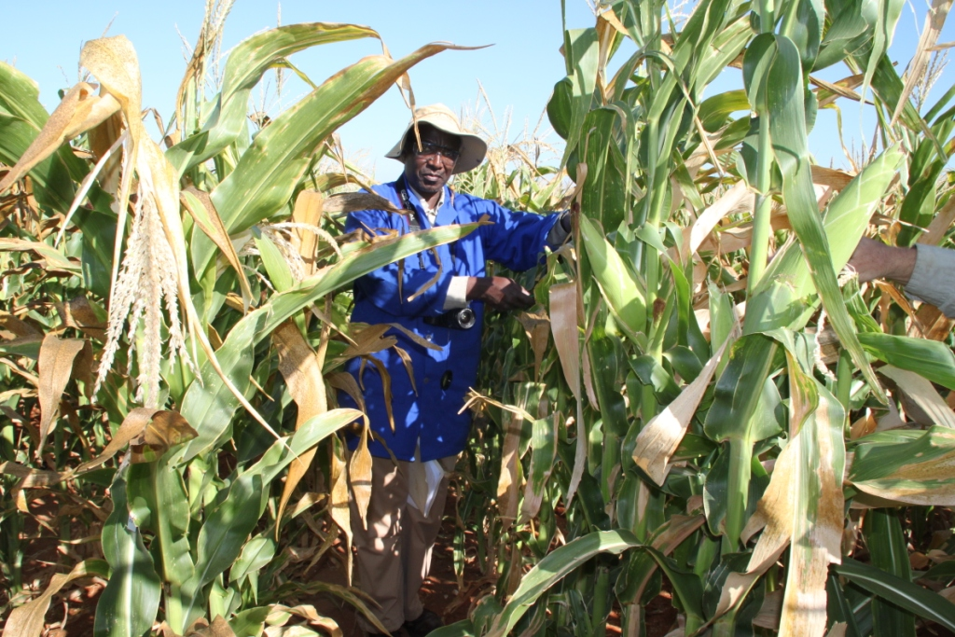
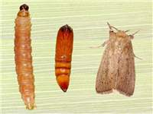
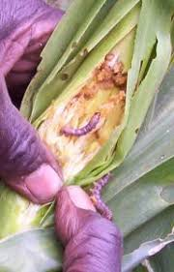
2…Impact of Stem borers and FAW on Maize in Africa
Stem borers
Annual damage on maize by stem-borers in Kenya is 400,000 tons valued at > USD 90 million
Estimated maize annual yield losses by FAW of 8.3–20.6 million tons (USD 2.48 – 6.19 billion)

Slide 13
TELA Project Countries
TELA Project Countries
Ethiopia
Kenya
Mozambique
Nigeria
Tanzania
Uganda
South Africa

Slide 14

2… WEMA-TELA Project Strategies and Product Options
Multi-pronged product pipeline using Conventional Plant Breeding and Transgenics
Advanced
Plant
Breeding
QTLs
Double Haploid
Marker-assisted Selection
Products
Conventional hybrids
Transgenesis for Drought tolerance
Transforma-tion with CspB gene
Drought TEGO® 120
GM drought-tolerant maize
Bt+DT maize
Bt maize
TELA Maize
Transgenesis for stem borer resistance
Transformation
Gene-stacking

Slide 15
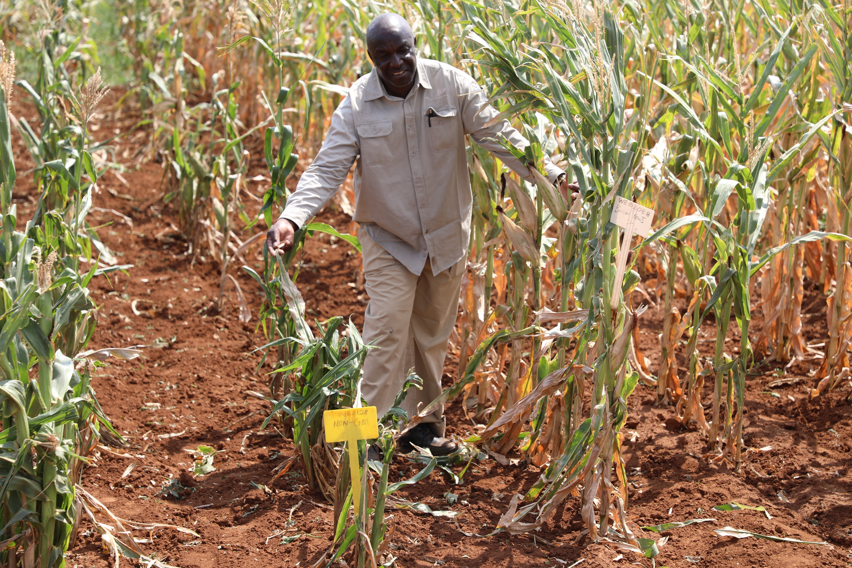
1…Combined Results of Stacked DT + Bt Across 5 Countries Under Stem borer and FAW
Non-GM
GM – Bt Maize (TELA)

Slide 16
Re-cap: TELA Maize Project
Steady progress attained over the last 14 years; with a couple of challenges
Field testing of TELA maize in 7 project countries
Commercial release approval secured in South Africa
Environmental Release approvals in Kenya, Nigeria, Mozambique & Ethiopia
Restrictive regulations slowing/disrupting progress in Uganda and Tanzania

Slide 17
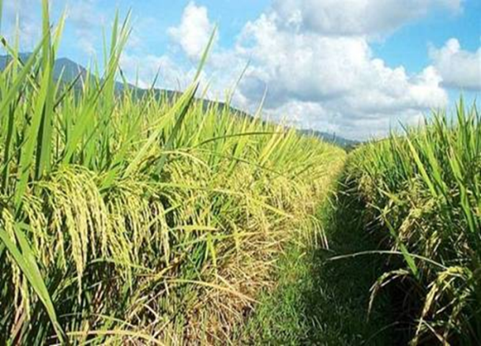
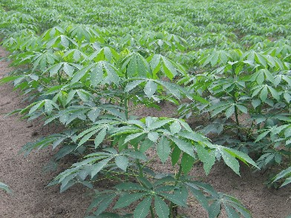
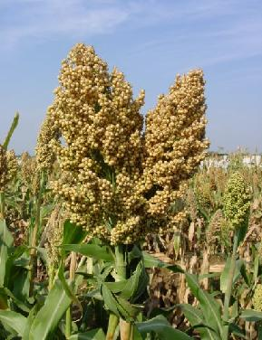
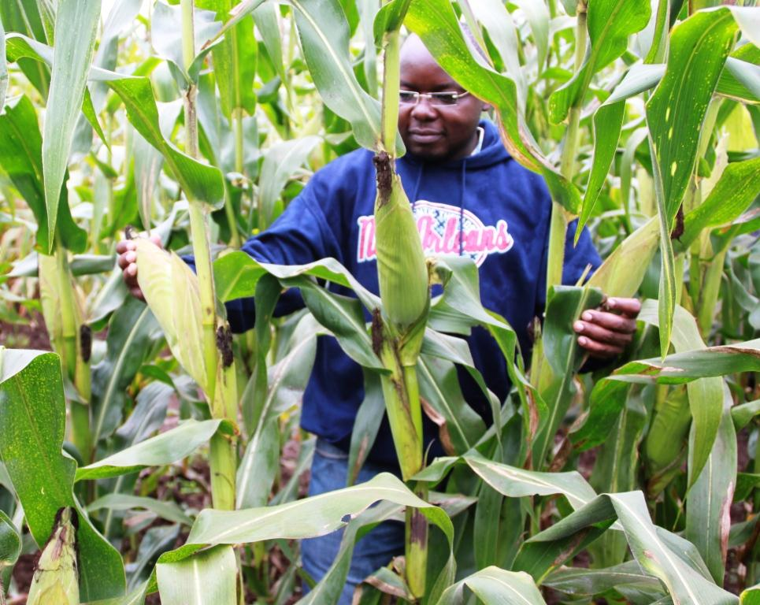
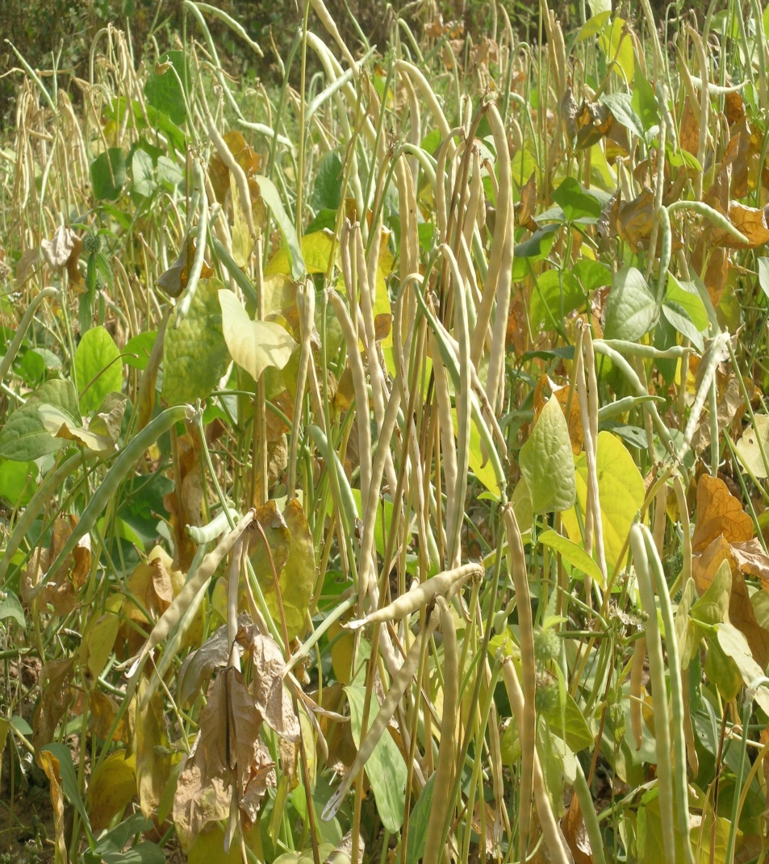
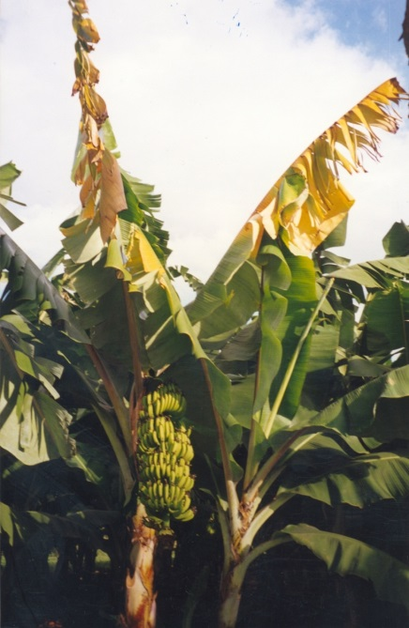
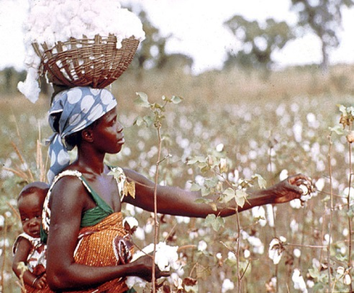
Pipeline of GM crops in Africa
Over US$ 0.7B of investment!
Several crops are in the pipeline
Expected release dates – 2015 through to 2022

Slide 18
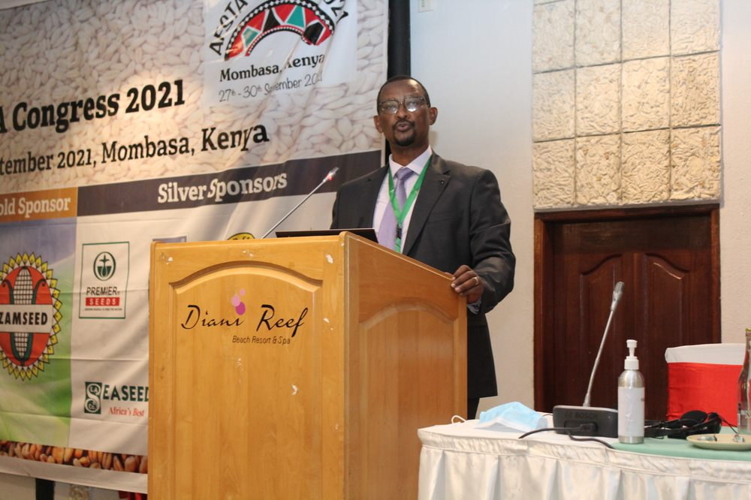
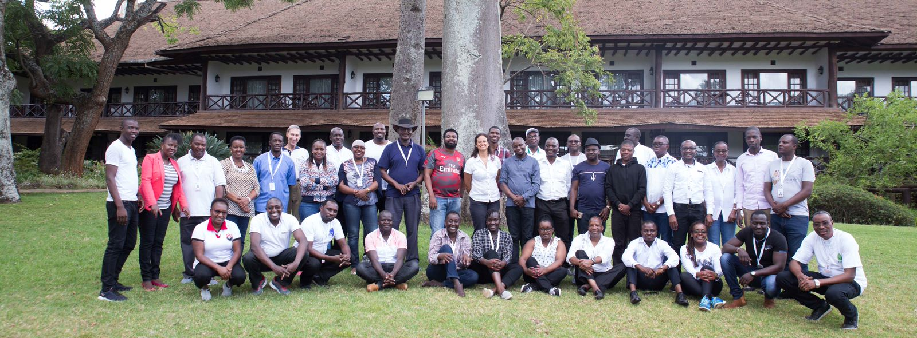
Why partner with AATF
Strong strategic public-private partnerships with established research institutions for technology development and networks of technology delivery partners and other stakeholders, including seed companies, National Seed Trade Associations (NSTA) and National Seed Authorities (NSA).
Availability of pipelines of new innovative products that are adaptable and provide solutions to farmers’ challenges.
Proven track record of effective adaptation and commercialization of improved technologies and rapid adoption by farmers.

Slide 19
THANK YOU
www.aatf-africa.org
+254 735 99 22 03
f.nangayo@aatf-africa.org

